Slide 1
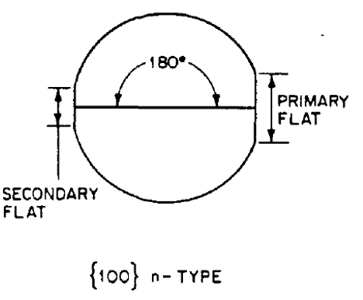
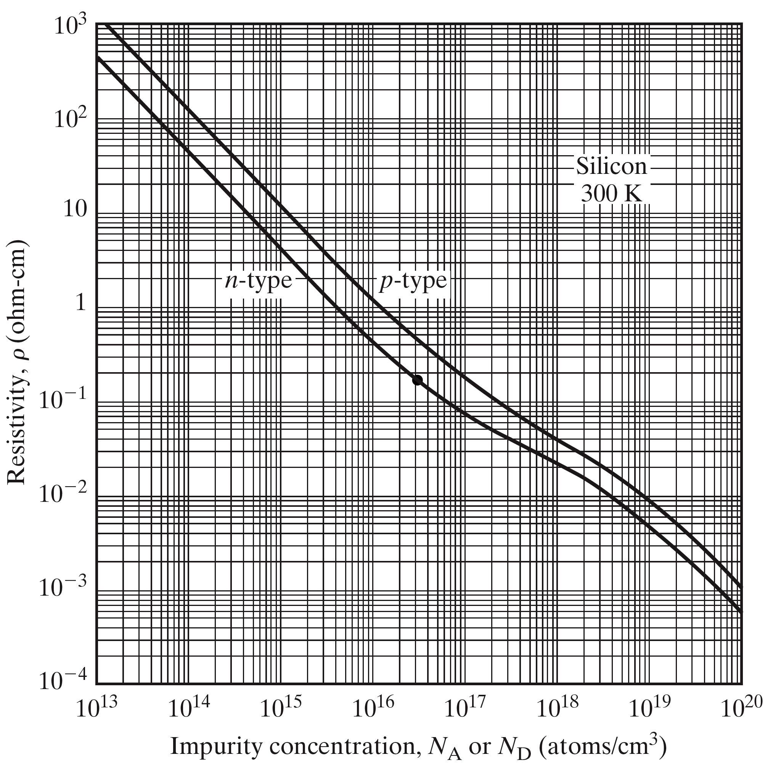
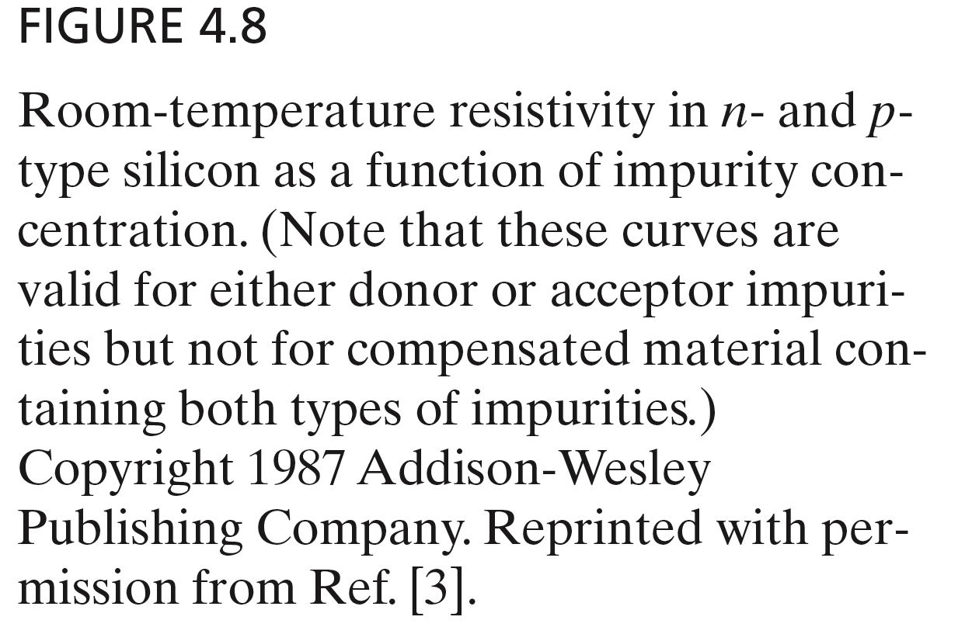
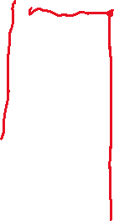
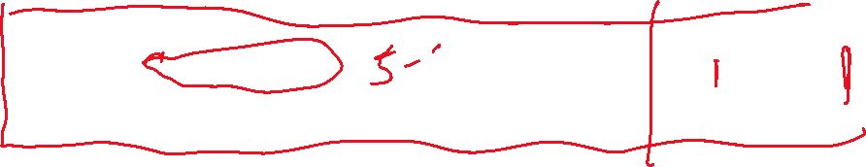
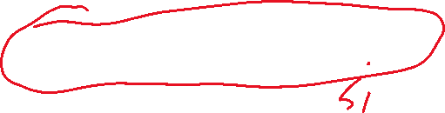
EE 3311/7322 MOSFET Fabrication Traveler
(Fall 2022)
Wafers specification | 4” N/Ph <100> 1-10 ohm-cm; 500-550µm Thick SSP Prime Grade Si wafers w/ 2 Semi-Std Flats
5 ohm-cm corresponds to ~ 8 x 10¹⁴/cm³ n-dopant atoms
Revised September 12, 2022

Slide 2
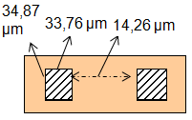
Step 1 - Define Source and Drain (Lab 1 and Lab2), n-type <100> wafer
Lab 1
Notes
Side view
Top view
1-1. Clean Wafers 20 min 1:10 BOE:Water
1-2. Initial oxidation 1000 °C in steam 100 sccm O₂ For 5 hours 20min -target 10,000Å | Wet oxide
1-3. Measure the oxide thickness by Ellipsometer | This measurement will be used for homework assignment
1-4. Dehydration bake 120 °C for 20 min
1-5. Spin Resist – KL 5315 3000 rpm for 30 sec Target thickness 13000 Å
1-6. Soft Bake 90 °C for 1 min hotplate.
1-7. Align/Expose _4_ sec | Determine the Z value for exposure: subtract 1.5 from the Z value at which mask pops
1-8. Develop in AZ726 for _45_ sec
1-9. Rinse with DI water and blow dry with nitrogen
Fig. 1-1
SiO₂
Fig. 1-2
Photoresist
Fig. 1-5
Fig. 1-7
MASK 1
Fig. 1-8

Slide 3
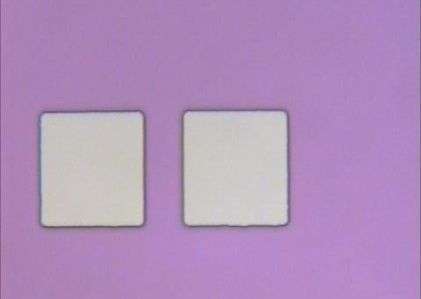
Step 1 - Define Source and Drain (Lab 1 and Lab 2)
continued
Lab 2
Notes
Side view
Top view
1-10. Bake 120 °C for 5 min
1-11. Etch field oxide in BOE full strength at 43 °C for 2 min | BOE 6:1 components: HF 7.13-7.3 wt%; NH4F 33.85-34.85 wt% *
1-12. Spray Rinse with DI water and blow dry with nitrogen
1-13. Inspect for complete removal of oxide | Signs for complete removal of oxide: undercut along the edge of the windows (most conclusive one); White/yellow color in the windows; water beads on each die upon the wafer being taken out of the etchant;
1-14. Strip resist with acetone followed by IPA, then blow dry with nitrogen | Three times
1-15. Measure Source-Drain spacing and dimensions, and take photos
Fig. 1-13
Fig. 1-14
EVANS 3311
Sample Device 2 photo Step 1-15 (Lab 1)
*http://www.kmgeci.com/products/BOE_6-1_B_408-062070_2008-12-09.pdf

Slide 4

Step 2 – Doping of Source and Drain (Partially Offline)
Lab 3
Notes
2-1. Pre-clean using Piranha strip mixture Sulfuric Acid :Hydrogen Peroxide (60:40) for 3 min | Each day use freshly prepared Piranha strip mixture. Piranha etching makes wafer more hydrophilic (no beading)
2-2. Rinse with DI water and blow dry with Nitrogen
2-2-1 Dehydration bake on hot plate @125°C for 2min
2-3. Spin on Boron Dopant at 4000 rpm [for 30 sec] for target thickness 3000 Å | Honeywell See manufacturer’s (Honeywell) datasheet
2-4. Pre-deposition diffusion at 1000 °C (see temp profile)
2-5. Remove “Spin-on Boron” in HF:DI water (1:10) for 2 min @ room temperature | Sign for good removal of boron: white/yellow color in the window with a slight shadow
2-6. Rinse with DI water and blow dry with Nitrogen
2-7. Drive-in diffusion at 1000 °C for 80 min in steam. Target oxide thickness: 5000 Å
Side view
Spin-on Boron
Top view
Fig. 2-3
Fig. 2-4
Fig. 2-5
SiO₂
Fig. 2-7

Slide 5
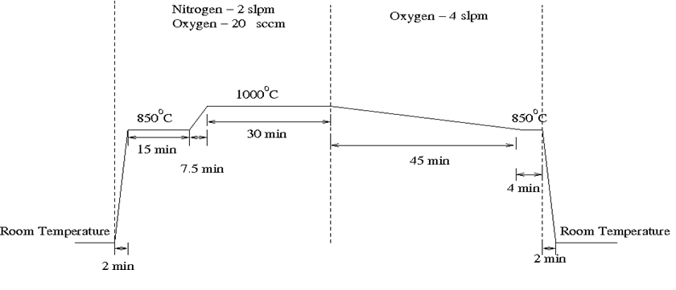
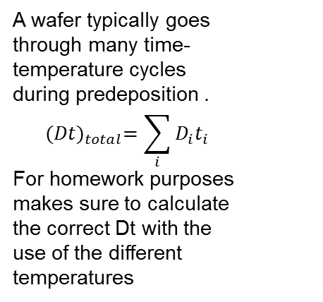
Diffusion Temperature Profile of Step 2 (in previous page)
I. Predeposition diffusion temperature profile ( corresponding to 2-4 in Step 2)
II. Drive-in diffusion temperature profile ( corresponding to 2-7 in Step 2)
1000 ⁰C for 80 min
25ºC
25ºC
The temperature ramp is the wafer temperature change from the room temperature to the furnace temperature when loading or unloading the wafers to the furnace. This loading or unloading wafers step takes about 3-4 minutes.

Slide 6
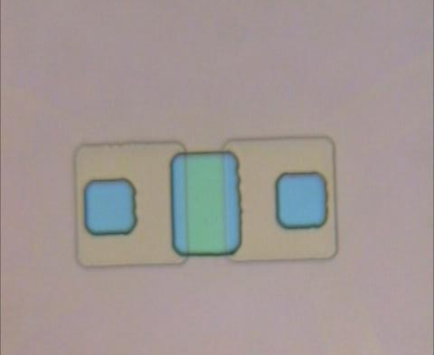
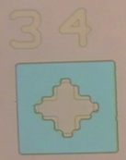
Step 3 - Define Gate and Pre-Contacts (Lab 4 and Lab 5)
Side view
Top view
Lab 4
Notes
Photoresist
Lithography for Gate
3-1. Bake 120 °C for 20 min
3-2. Spin Resist – KL 5315 at 5000 rpm for 30 sec Target thickness ~1.1 μm
3-3. Soft Bake 90 °C for 1 min
3-4. Align/Expose _3.0_ Sec | Find out the Z value for exposure before alignment. Determine the Z value for doing alignment: Subtract 2 from the Z value for exposure
3-5. Develop in AZ726 for _60_ sec
3-6. Blow dry with Nitrogen
Fig. 3-2
Note cross sections not to scale.
MASK 2
Fig. 3-4
Fig. 3-5
EVANS 3311
EVANS 3311
Sample Device 2 photo Step 3-5
Notes:
-Change figure 3-5 to match 3-4
-rotate lab photo to match figures
-note that cross sections not to scale…

Slide 7
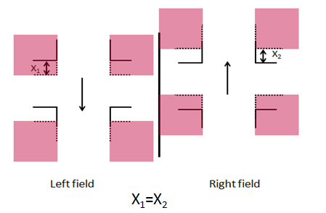
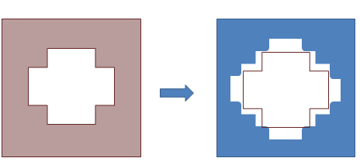
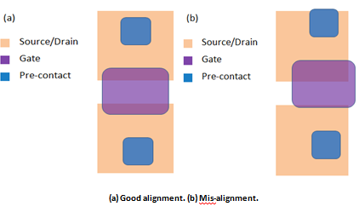
Notes for Lab 3 Alignment:
Align streets and alleys for rough alignment
Use device 34 for fine alignment
Check device two and make sure the ratio between source/gate overlap and drain/gate overlap is no greater than 0.7 as well as centered

Slide 8
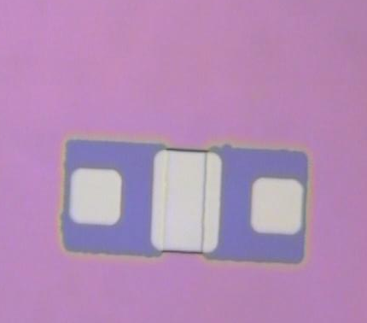
Step 3 - Define Gate and Pre-contacts (Lab 4 and Lab 5) continued
Lab 5
Notes
3-7. Bake 120 °C for 5 min
3-8. Etch field oxide in BOE full strength at 38 °C for 1 and 1/2 min for whole wafer, 10 more sec for thicker parts | Oxide in the gate takes longer than that in the pre-contacts to remove
3-9. Spray Rinse with DI Water and blow dry with Nitrogen
3-10. Inspect for complete oxide removal | All three windows (gate and two pre-contacts) have to look clear
3-11. Strip Resist with Acetone followed by IPA, then blow dry with nitrogen | Three times
3-12. Inspect and take photos
3-13. Pre-gate cleanup in piranha strip H₂SO₄:H₂0₂ (60:40) for 5 min | Each day use freshly prepared piranha strip
3-14. Rinse with DI water for 3 min and blow dry with nitrogen
3-15. Gate oxidation at 1000 °C in oxygen for 80 min and measure gate oxide thickness Target 700 – 900 Å | Color chart can be used to estimate gate oxide thickness
Top view
Side view
Fig. 3-9
Fig. 3-12
SiO₂
Fig. 3-17
EVANS 3311
Sample Device 2 photo Step 3-14 (Lab 5)
Notes:
-add step where blank silicon wafer is included in step 3.15-17 to measure gate oxide thickness

Slide 9
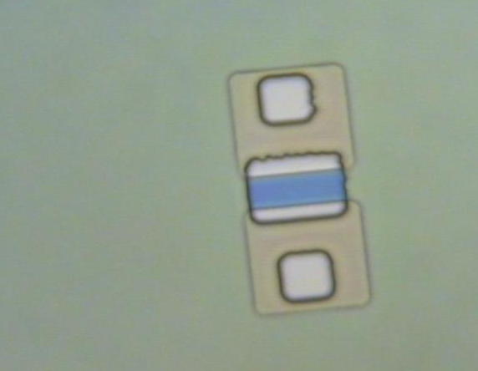
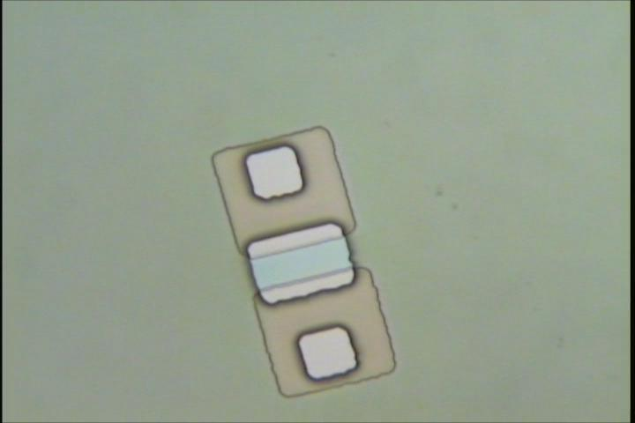
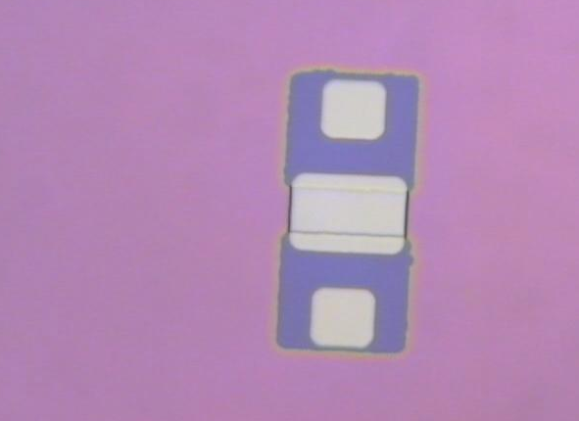
Notes for Lab 5 Etching:
If color appears in source, gate, or drain where photoresist does not protect Device 2, wafer will need additional etching to remove exposed oxide
A fully etched Device 2 should all be uniformly light grey/white in color
Removal of photoresist will uncover oxide not etched in BOE
EVANS 3311
EVANS 3311
EVANS 3311

Slide 10
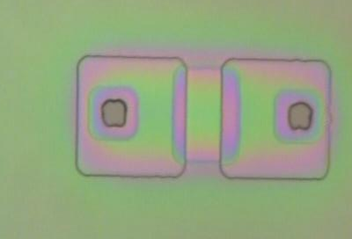
Step 4 - Define Contacts (Lab 6 and Lab 7)
Side view
Top view
Lab 6
Notes
Photoresist
Lithography for Contacts
4-1. Bake 120 °C for 20 min
4-2. Spin Resist – KL 5315 at 4500 rpm for 30 sec Target thickness 12000Å
4-3. Soft Bake 90 °C for 1 min
4-4. Align/Expose _4.0_ sec | Challenging for the eyes because the entire device pattern is covered by the red pattern on mask except the two little contact windows.
4-5. Develop in AZ726 for 1 min
4-6. Rinse with DI water and blow dry with nitrogen
Fig. 4-2
MASK 3
Fig. 4-4
Fig. 4-5
EVANS 3311
Sample Device 2 Step 4-5 (Lab 4)
Notes:
-next year take photo after oxide growth and before this lab

Slide 11
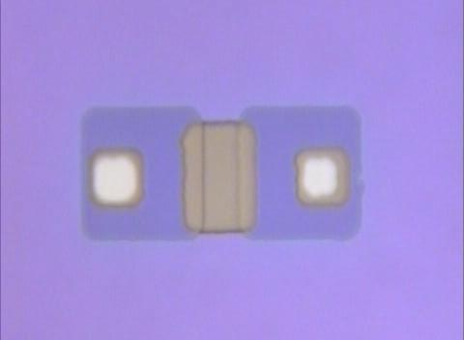
Step 4 - Define Contacts (Lab 6 and Lab 7)
continued
Lab 7
Notes
Side view
Top view
4-8. Hard bake on hot plate at 120 °C for 5 min
4-9 Etch field oxide in BOE full strength at room temp for 1min 30 seconds | Gate oxide does not take that much longer time to remove than previous oxides
4-10. Rinse with DI water and blow dry with nitrogen
4-11. Inspect for complete oxide removal
4-12. Strip Resist with Acetone & IPA, then blow dry with nitrogen | Three times
4-14. Inspect and take photos
Fig. 4-9
Fig. 4-12
EVANS 3311
Sample Device 2 photo Step 4-14 (Lab 4)
Notes:
-make adjustments to side views so that they match earlier adjustments (move opening in and have gate overlap source/drain)
-rotate photo and include step

Slide 12
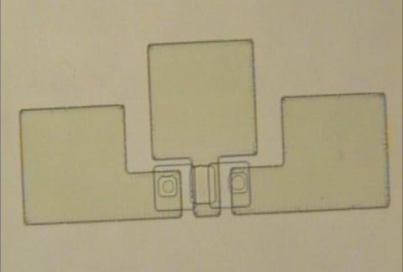
Step 5 – Metallization (Lab 8 and Lab 9)
Lab 8
Notes
Side view
Top view
Aluminum
5-1. Deposit alloy of aluminum –silicon-copper using RF Sputter (offline) Target 7000 – 9000 Å | 15 min AR 30sccm 400W RF
Lithography for Probe Points
5-2. Bake 120 °C for 20 min (off-line)
5-3. Spin Resist – KL 5315 at 5000 rpm for 30 sec Target thickness ~ 1.1 μm
5-4. Soft Bake 90 °C for 1 min
5-5. Align/Expose _3.5_ sec
5-6. Develop in AZ726 for 1 min
5-7. Rinse with DI water and blow dry with nitrogen
Fig. 5-1
Fig. 5-3
Fig. 5-5
MASK 4
Fig. 5-6
EVANS 3311
Sample Device 2 photo Step 5-6 (Lab 5)
Notes:
-slight adjustments for sideviews
-photo rotated

Slide 13
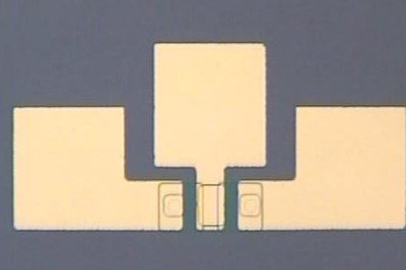
Top view
Step 5 – Metallization (Lab 8 and Lab 9)
continued
Side view
Lab 9
Notes
5-8. Hard bake on hot plate at 120 °C for 5 min
5-9. Etch aluminum in 16:1:1:2 Al etch at 30 – 35 °C till clear plus 15 sec | Phospheric acid: 73 wt%; acetic acid:1.3-5 wt%; nitric acid: 3.2 wt%; water: 18-22 wt%*
5-10. Rinse with DI water and blow dry with nitrogen
5-11. Inspect
5-12. Strip resist with acetone followed by IPA, then blow dry with nitrogen | Three times
5-13. Inspect and take photos
Fig. 5-9
Fig. 5-12
EVANS 3311
Sample Device 2 photo Step 5-13 (Lab 5)
*http://sct.uab.cat/l-amb-controlat/sites/sct.uab.cat.l-amb-controlat/files/AlEtch.pdf

Slide 14
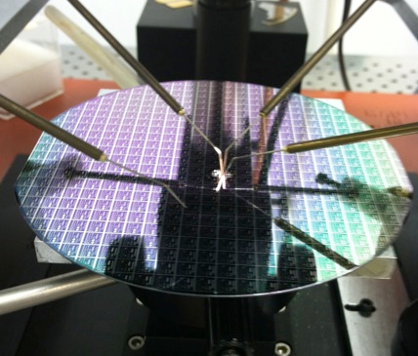
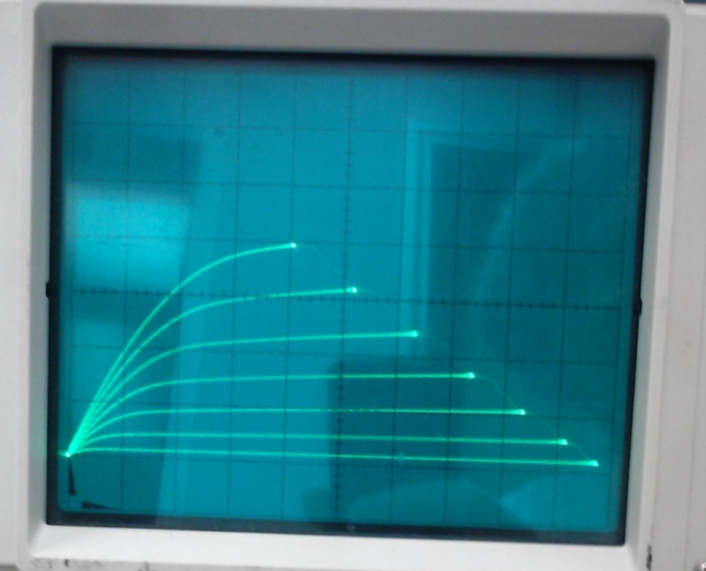
Step 6 – Alloy and Test (Lab 10)
Lab 10
Notes
6-1. Alloy at 350 °C for 20 min
6-2. Test devices
Wafer probe setup (Lab 10)
Device 2 IV curve (Lab 6)

Slide 15
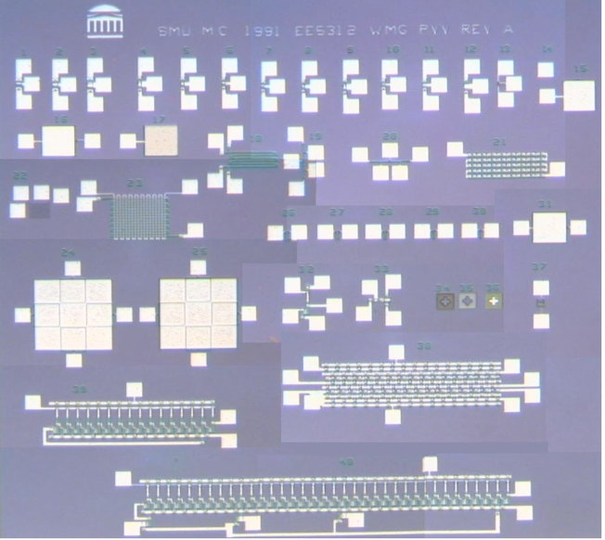
3311 MOSFET Metal Level

Slide 16
List of Test Structures on 3311 Chip
This chip is a metal-gate, thick-oxide, PMOS process with boron diffused junctions
1-3. Wide thin-oxide devices of various L’s.
4-6. Narrow thin-oxide devices of various L’s.
7-9. Narrowest thin-oxide devices of various L’s.
10. Short field device.
11. Longer field device.
12. Longest field device.
13. Super-tiny thin-oxide device. Probably won’t work.
14. Bond pad on field oxide.
15. Larger-area metal on field oxide.
16. Metal-to-diffusion thin-oxide capacitor.
17. Diffusion capacitor.
18. Diffusion serpentine with four (Kelvin) contacts for diffusion sheet resistance.
19-20. Vertical and horizontal contact-to-diffusion alignment measurement device.
21. Metal-diffusion contact string. Use to check contact integrity.
22. Thin metal serpentine with four (Kelvin) contacts for metal sheet resistance. This device is probably too narrow to be etched without breaking the connections.
23. Metal serpentine over diffusion serpentine. Use to check metal continuity and diffusion sheet resistance.
24. Metal to diffusion alignment measurement device without gate oxide: use to automatically measurement metal to diffusion alignment.
25. Metal to diffusion alignment measurement device with gate oxide: use to automatically measurement metal to diffusion alignment, or gate oxide to diffusion alignment.

Slide 17
List of Test Structures on 3311 Chip, cont’d
26-30. Diffusion-to-diffusion spacing, going from widest on left to narrowest on right. Use to check if diffusions are touching, or to measure punch-through.
31. Metal-to-diffusion capacitor. Metal to the left; diffusion to the right.
32. Enhancement-load ratioed inverter: Bond pads, going clockwise and starting at 12 o’clock: VDD; output; VSS; input; VGG.
33. Sample-and-hold gate. Bond pads, going clockwise and starting at 2 o’clock: Sense transistor source or drain; sense transistor drain or source; sample gate; input.
34. Alignment cross: thin oxide to diffusion.
35. Alignment cross: contact to thin oxide.
36. Alignment cross; metal to contact.
37. A lateral grounded-base PNP transistor. The emitter is at the top, and the collector is at the bottom. The n-type substrate is the base.
38. A sixteen-stage shift-register. Bond pads, going clockwise and starting at 12 o’clock: VDD, VSS Phase 2 Clock, Output, VGG, VDD, VSS, Input, Phase 1 Clock.
39. A ring oscillator with fifteen inverters and a buffer. Bond pads, going clockwise and starting at 1 o’clock: VDD; output from buffer; VSS; VGG.
40. Ring oscillator with thirty-five inverters plus output buffer connected to, but not in the ring. Bond pads, going clockwise and starting at 1 o’clock: VDD; output from buffer; VSS; gate to provide input for 25 inverter ring; gate to provide input for 15 inverter ring; gate to provide input for 35 inverter ring; VGG. The intermediate taps for inputs likely will not work since the input will be contending with the fixed output of the previous stage.
Circuits 38, 39, and 40 may not work due to design-rule violations in the metal leads which results in many of the circuit connections being not connected.
Note: many years ago we made some changes to the mask set so that circuits 38, 39 and 40 would have a better chance of working. However, we just noticed that we are still using the old mask set for EE 3311.

